Slide 1

Web scraping to gain company insights

Slide 2
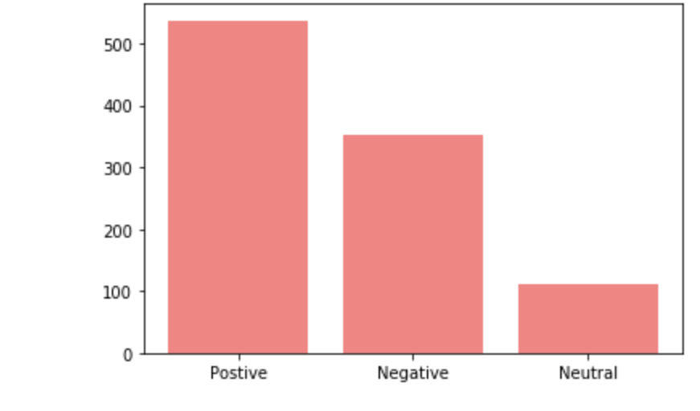
Insights: Bar plot of reviews
From the analysis, there are 537 positive reviews, 352 negative reviews and 111 neutral reviews.

Slide 3
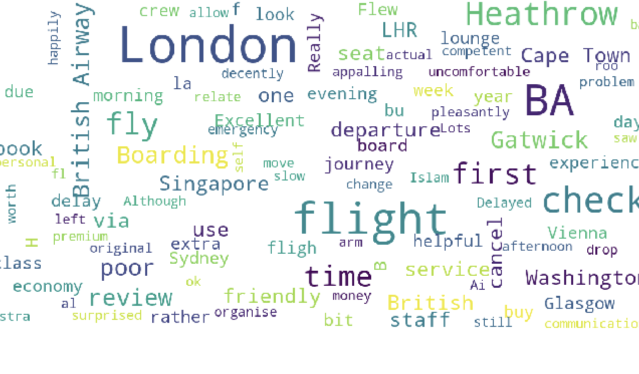
Insights: Word cloud of keywords used in reviews
Word cloud of keywords used in reviews

